Slide 1
Access to Opportunity Microtransit Project
November 21, 2019
On-Ramp MOD On-Ramp Program Workshop

Slide 2
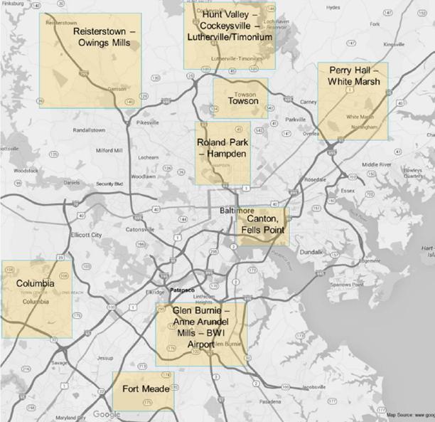
Project History
2015 – “pop-up” mobility proposed with BaltimoreLink
2016 – Advertised RFI for 9 potential areas, focused on
Connections to jobs
Connections to fixed-route transit
Supplementing fixed-route service hours or frequency
2

Slide 3
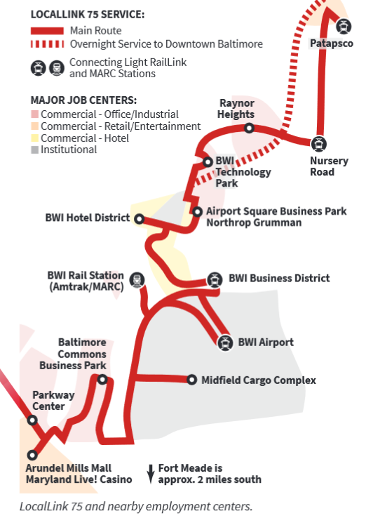
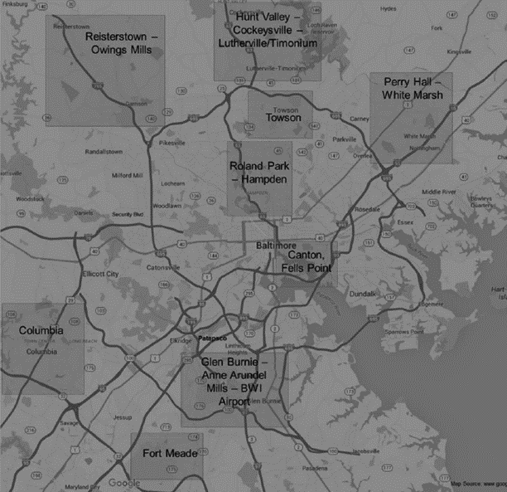
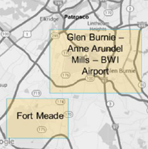
MOD On-Ramp
2018 - Applied with narrower focus area
Previous studies, stakeholder engagement, data
Strong case for third shift workers, persistent need
Identified opportunities with LocalLink 75.
3
3
Notes:
Animation highlights the initial project area including Fort Meade.
Previous studies:
“Last Mile Report” by CMTA for Opportunity Collaborative (2014)
“Strong Workforce, Strong Economy: Baltimore Regional Workforce Development Plan” by Opportunity Collaborative, BMC/BRTB (2015)
“The Transit Question: Baltimore Regional Transit Needs Assessment” by BMC (2015)
“Understanding Divided Baltimore”, a lecture and research lead by UB and BNIA (2016)
South Baltimore Gateway Master Plan by SBGP

Slide 4
Project Overview
Summer 2018
Summer 2019
Fall 2019
Winter 2020
Summer 2020
Fall 2018
Winter 2019
WE ARE HERE
Kick-Off
Interviews, Route Tour
Data Collection, Surveys
Concept Development and Analysis
Finalize Business Plan, RFP, Feedback
Receive Proposals, Award Contract, Mobilize
4

Slide 5
Current Service
24/7 service, 56 bus stops
30-minute to 1-hour headways
50 to 70-minute travel time
Connects to rail, bus, local services
Ad-hoc extensions for industrial parks
LL75 vs. LocalLink Average
Daily ridership: 1,200 vs. 2,100
On-time Perf.: 62% vs. 72%
Cost per Trip: $11 vs. $6
Length in miles: 32 vs. 14
5

Slide 6
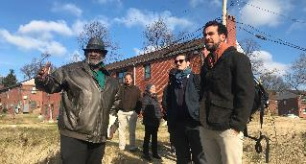
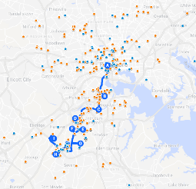
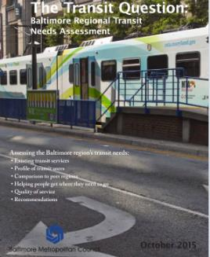
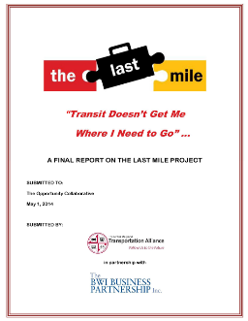
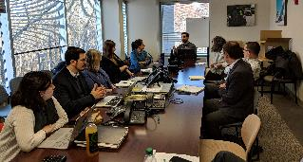
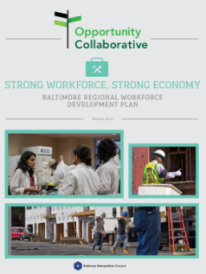
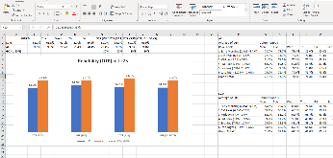
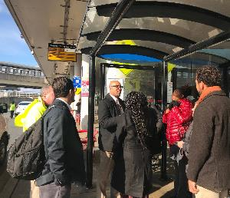
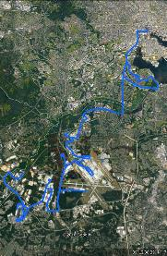
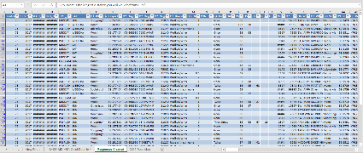
Problem Identification
+
+
Site visits, route tours, interviews, rider surveys
Data and spatial analysis
Local studies, research
6

Slide 7
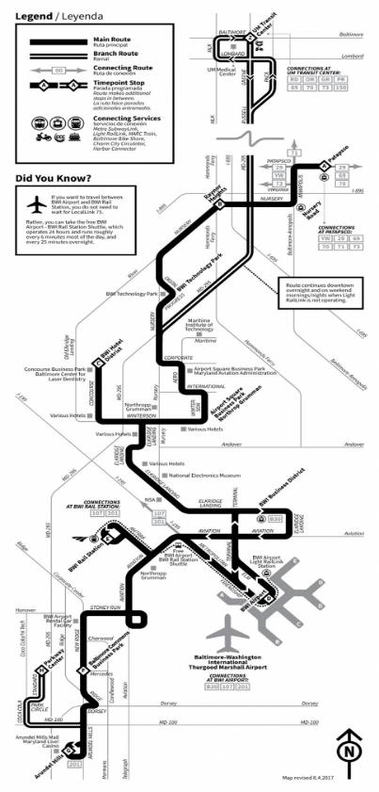
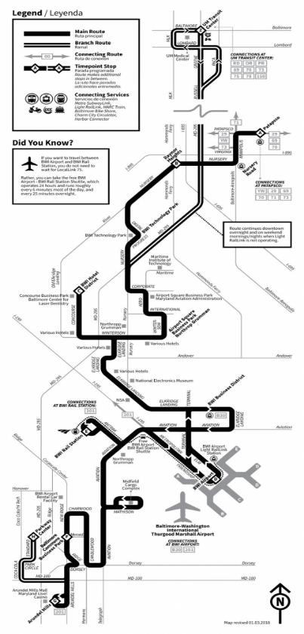
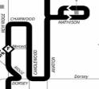
Summer 2017
Winter 2018
Fall 2018
7

Slide 8
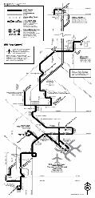
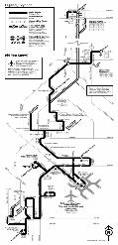
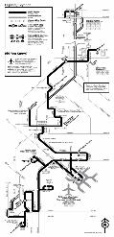
Problems Identified
Expanding Technology Park
Rapid Suburban Development
Employment centers oriented away from transit, new development expected
OTP has fallen since the initial launch of a more streamlined LL75 in 2017
Future 24-hour Maintenance Facility
Expanding
24-hour Cargo Complex
8

Slide 9
Problems Identified
Transit Travel Time vs. Driving
Expect commute by bus to take about 1.7x longer than driving.
On LL75, taking the bus is 3.2x longer than driving
1.6x longer from Patapsco to the airport (northern half)
2.6x longer from the airport to the mall/casino (southern half)
10
10
20
30
20
40
50
60
70
Source: Census Household Travel Survey, Schedule and GTFS data
9

Slide 10
Problems Identified
10

Slide 11
Problems Identified
Unsignalized Entrance
End
More learned from surveys
Total of 310 complete responses
70% transfer more than once, 32% transfer twice to complete their trip
93% walk to/from the bus stop.
“long, lonely walk” around/across parking lots, near busy traffic, etc.
74% pay cash, 14% pay cash for one-way fare
Almost everyone has smartphone, few have data plans, and fewer use credit cards or mobile payment apps
Fewer than 25% use Uber or Lyft
MTA Light Rail
High Speed Road
Desire Line
CSX Rail
Desire Line
Start
Start
11
11

Slide 12
Proposed Solution
Why: Improve the reliability, flexibility, and overall quality of service for existing riders and potential new riders.
How: Leverage available technology, vehicles, and service models to enable on-demand, right-sized, flexible service.
12

Slide 13
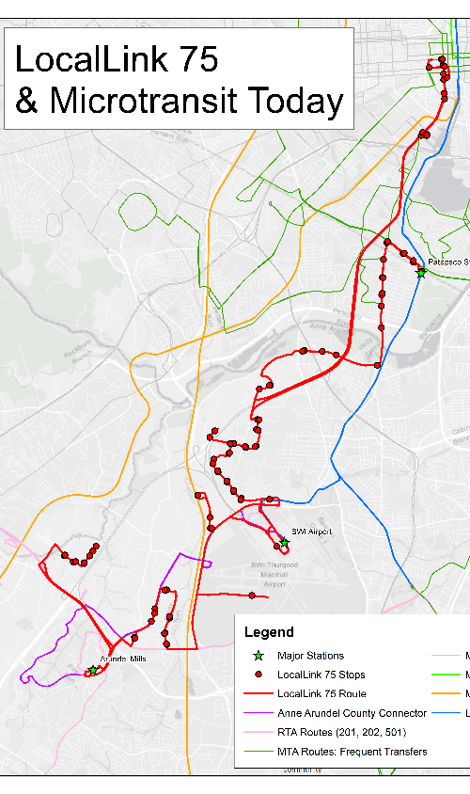
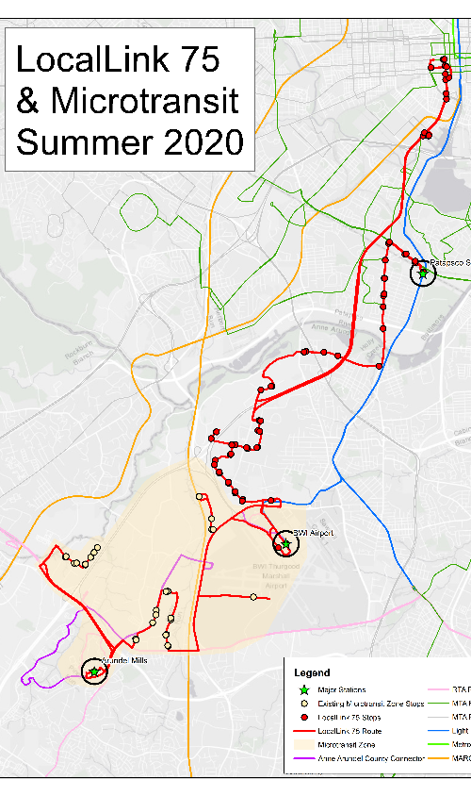
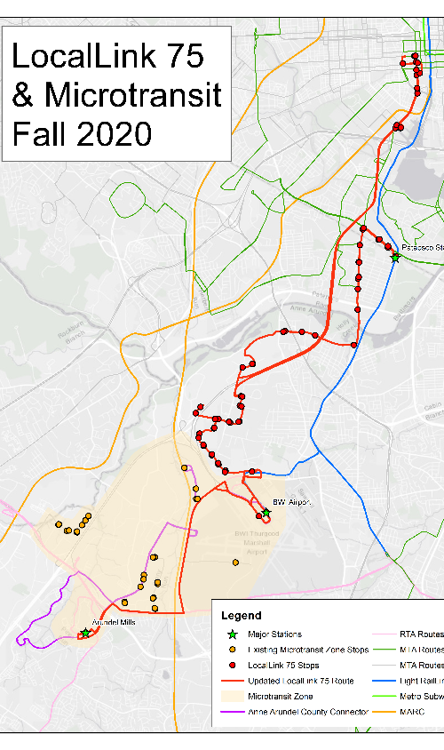
LL75 will remain
24/7 service
same headways
Union operated
LL75 unchanged
LL75 express after airport
13

Slide 14
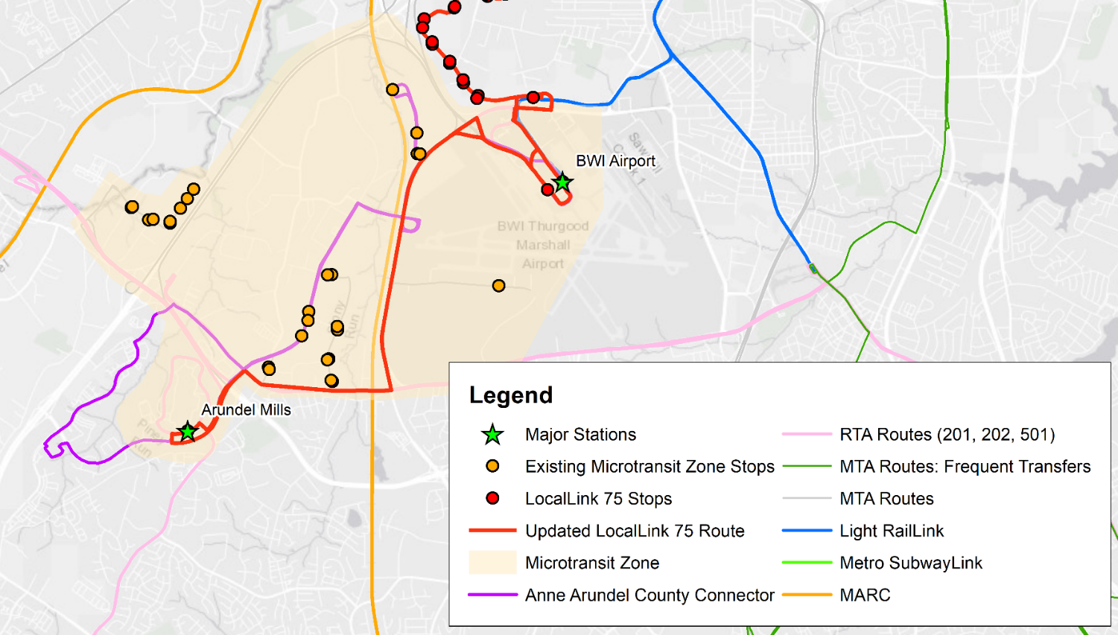
Fall 2020 (close up)
New Microtransit will
Be contracted
Operate 24/7
Have no assigned alignment
Stops by request only
Share airport and mall stops w/ 75
Pick up the 12 stops removed from the new express segment of LL75
14

Slide 15
Impact on Riders
LL75 riders will experience
higher on-time performance
shorter travel time
Riders on microtransit will experience
shorter wait time and travel time
additional transfer for some
LL75 improvements may attract new riders to core service
15

Slide 16
Next Steps
Advertise RFP and award contract
Engage and educate riders
Mobilize and test the pilot service
Continue outreach, education, evaluation, and iteration of pilot service
16
Notes:
Award a two-year contract
Re-engage with local partners, businesses, and riders
Implement pilot in summer 2020
Modify LocalLink 75 in fall 2020
Evaluate and report out on pilot phases, including expected performance improvements on LocalLink75

Slide 17
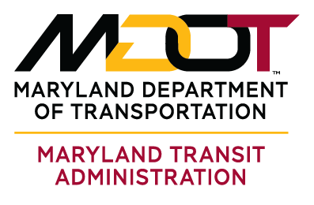
Thank you!
K. Jade Clayton
Senior Planner and Project Manager
Office of Planning and Programming jclayton@mdot.maryland.gov
410-767-7771

